Slide 1



Lakshmanan
09-OCT-2024

Slide 2
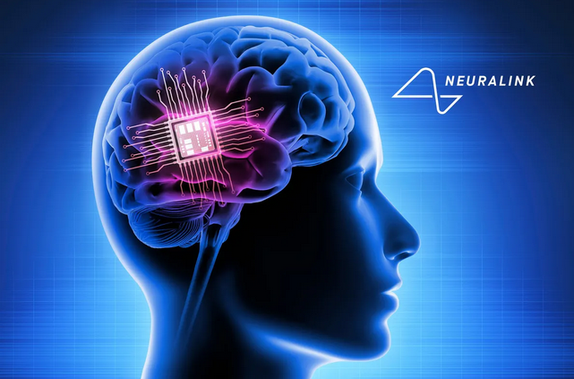
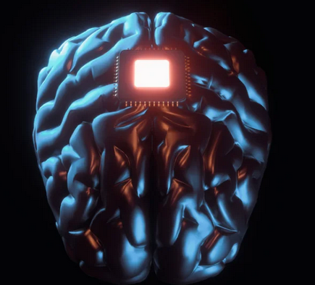
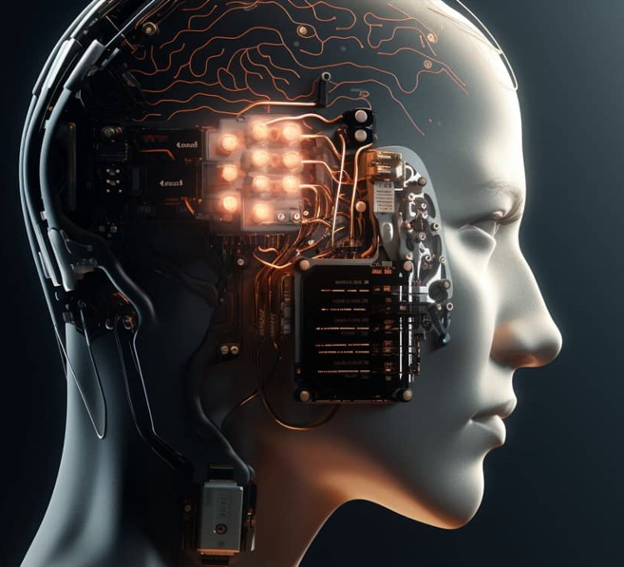
Neuralink :
Neuralink is a neurotechnology company co-founded by Elon Musk in 2016 with the goal of developing brain–machine interfaces (BMIs) or brain–computer interfaces (BCIs). These devices are designed to directly connect the brain to computers, allowing for communication between neurons and machines. Here are key insights and technical details on the project
Objective and Vision:
To create a high-bandwidth, minimally invasive brain interface that can enable humans to interact with technology in unprecedented ways. Musk has spoken about goals such as treating neurological conditions.
One of Neuralink's more futuristic ambitions is enabling "symbiosis" between humans and AI. In Musk's view, this could be a way to safeguard humanity in a future where AI might surpass human intelligence.
Neuralink Device & Technology:
Brain Chip (N1 Implant): The Neuralink device is essentially a small chip (N1) that can be implanted in the brain. It includes ultra-thin, flexible threads (about 4–6 μm thick, thinner than human hair) that are inserted into the cortex of the brain to detect and stimulate neural activity.
Electrode Threads: These threads are designed to read signals from neurons and, conversely, to deliver electrical impulses to specific regions of the brain. This can potentially help treat neurological disorders, restore motor function, or augment sensory capabilities.
Implant Procedure: The implantation process is done by a surgical robot. The robot inserts the fine electrode threads into the brain with extreme precision, avoiding blood vessels and minimizing trauma. This procedure would ideally be fast and involve minimal recovery time.

Slide 3
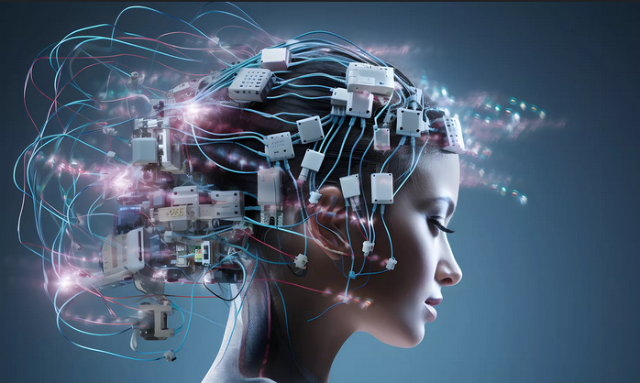
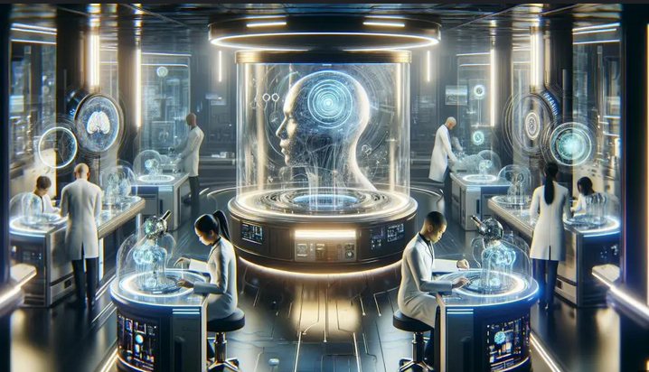
Applications of Neuralink Technology :
Medical Uses (Short-term):Treating Neurological Disorders: Early targets include restoring motor function in individuals with paralysis, treating diseases like Parkinson’s, epilepsy, Alzheimer’s, and potentially addressing conditions such as depression, anxiety, or addiction.
Prosthetic Control: It could allow amputees or paralyzed individuals to control prosthetic limbs or robotic devices using just their thoughts.
Human-AI Symbiosis (Long-term):Direct Brain Communication: Neuralink envisions a future where human brains can communicate directly with external devices or even each other. This could be for entertainment, productivity, or enhanced communication.
Cognitive Enhancement: The ability to improve memory, process information faster, or even upload new skills to the brain could theoretically be possible.
Telepathy and Virtual Reality: Future versions might enable mind-to-mind communication or provide a direct neural link to immersive virtual environments.

Slide 4
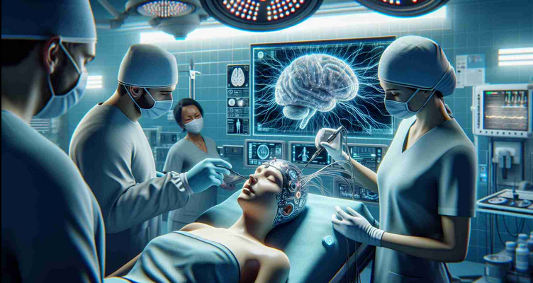

Advantages of Neuralink:
Medical Breakthroughs
Direct Brain-Machine Interaction
Research and Understanding of the Brain
Telepathic Communication and Virtual Reality
Disadvantages and Challenges of Neuralink:
Invasiveness and Safety Concerns
Privacy and Ethical Issues
Societal and Cultural Impact.

